Slide 1

Introduction and Project Overview
Monday 9am
Dr. Joe Stone
joseph.stone@shu.ac.uk; DrJoeStone

Slide 2
Morning Session
Welcome
Summer School Overview
Data Sources

Slide 3



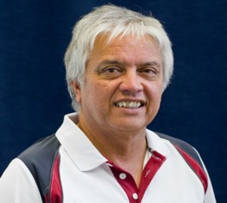
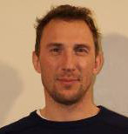
Staff

Slide 4
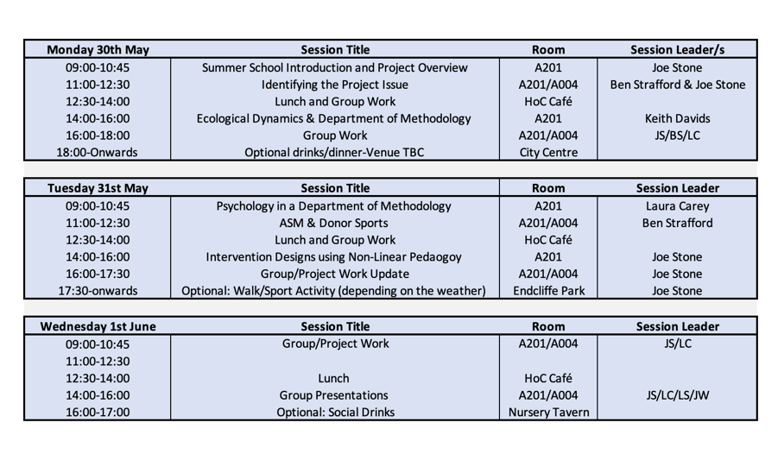
Schedule

Slide 5

School Overview
Work in small teams to solve applied sport science problems
Focus on Women's' Professional Football Teams
Each group will adopt the role of the coaching and sport science team for a professional English woman's team
Define a performance related problem and seek to develop intervention strategies using data to support your plan

Slide 6
The Scenario
Sat
Match Day
Sun
Rest Day
Mon
Previous Match Review
Tues
Wed
Thurs
Fri
Sat
Next Match Planning and Intervention Design
Intervention Design ready for afternoon training
Implement Intervention Design
Implement Intervention Design
Match Day

Slide 7
Key Project Milestones
1. Evaluate data sources
2. Select ONE key performance area to focus upon
3. Develop evidence on the performance area
4. Create a short-term intervention design using principles of Ecological Dynamics which could be implemented ready for the next fixture
5. Suggest strategies for longer term development of the performance area

Slide 8





Groups and Teams
Team | Arsenal | Chelsea | Manchester City | Manchester United | Everton
 | Group 1 | Group 2 | Group 3 | Group 4 | Group 5
Shu
Shu
Rouen
Rouen
Rouen

Slide 9

Get to know your groups
Your name
Sport or exercise you like to play/watch
Your main discipline area (e.g., Psychology, S&C, Performance Analysis….)
Favourite food
A “fun” fact about yourself

Slide 10
The Project Focus

Slide 11
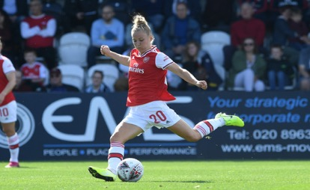
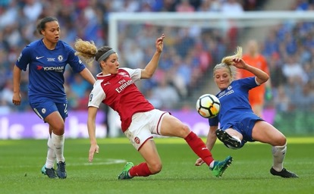
Starting point
Dynamic systems of play in invasion sports
Attack
Defence

Slide 12
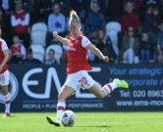
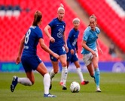
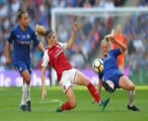
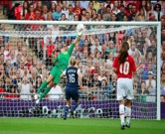
Dynamic System of Play
Attack
Defence
Scoring
Conserving an object or position
Recovering the object or position
Defending one’s goal

Slide 13
Tactical Problems: Invasion
Scoring: What is the main problem for poor conversion rate?
Scoring: What is the reason for poor attack efficiency?
Scoring: Where is the effective area for creating chances?
Scoring: What is the temporal pattern of shot attempts?
Conserving: What is the best strategy for building up attacks in terms of passing styles?
Conserving: What are the reasons for losing the ball possession?
Conserving: What is the role of speed in counter-attack play after the ball is regained?
Recovering: How the team recovers the ball to prevent goal conceding?
Defending: Where is the most vulnerable area to concede a goal?

Slide 14
Examples: Invasion sports
Critical Incident
Related PIs: Shots, Cross, Dribble, Set plays
Destabilisation
Related PIs: Blocking, Interception
Attack
Defence
Scoring
Conserving an object or position
Recovering the object or position
Defending one’s goal
Steady State
Related PIs: Pass, Positioning, possession
Smooth out
Related PIs: Interception, Tacking, Duels

Slide 15
Data Sources

Slide 16

Why do we need data?

Slide 17
Why use Performance Assessment?
We can collect data to aid with observation of performers which we may miss in real time
In your groups write down as many reasons as you can to why we might assess or record data during training and/or competition?
Notes:
MR

Slide 18
Why use Performance Assessment
Adapted list from Carling, Reilly and Williams (2009):
Notes:
JS - Discuss

Slide 19




Typical Data Sources

Slide 20
Data for the week

Slide 21
Watch the Video

Slide 22

Code/Tag Data
Pen and Paper, Excel or Nacsport

Slide 23
Pre-Tagged Wyscout Data

Slide 24
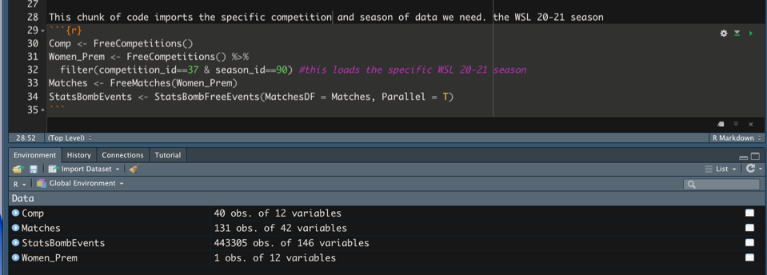
Pre-coded data
131 matches of data

Slide 25
Pre-coded data
131 matches of data
146 variables of data

Slide 26
Pre-coded data
131 matches of data
146 variables of data
443,305 observation

Slide 27
Pre-coded data
Results in 64,722,530 bits of data

Slide 28
Example Output

Slide 29
Is having more data better?
What's and Wherefore’s
Data interpretation is critical
Coaches running the data, not the data running the coaches
http://www1.skysports.com/watch/video/sports/rugby-union/9756589/sports-science-in-rugby-union

Slide 30
Performance Analysis
What data and interpretation does your group require to support issue and proposed intervention?

Slide 31
Which data to use?
Time is short, like in professional sport
Use the skillset of your group
Plan and distribute the work
Use the staff for advice to help if you are unsure
You need to be ready to present on Wednesday afternoon

Slide 32
Tasks
1. Map out which areas you want to start investigating
2. Start to examine the data sources
3. Define the area of interest you will investigate

